Slide 1




CONSUMER GOODS
AD - HOC INSIGHTS
CREATED BY : ASHWIN JADHAV
aTLIQ HARDWARE

Slide 2
Provide the list of markets in which customer "Atliq Exclusive" operates its business in the APAC region.
1.
Market
India
Indonesia
Japan
Philippines
South Korea
Australia
New zealand
Bangladesh
SQL QEURY :
SELECT DISTINCT market FROM dim_customer WHERE customer = 'Atliq Exclusive’ AND region = 'APAC';
INSIGHT : INDIA , INDONESIA , JAPAN , PHILIPINES , SOUTH KOREA , AUSTRALIA , NEW ZEALAND , BANGLADESH are the 8 markets in APAC reagion where Atliq exclusive operates its business

Slide 3
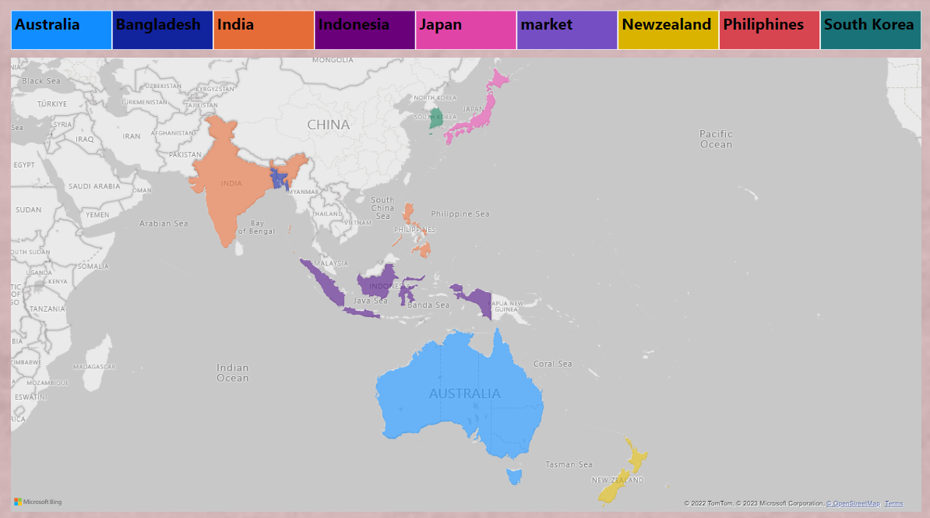
Provide the list of markets in which customer "Atliq Exclusive" operates its business in the APAC region.
1.

Slide 4
What is the percentage of unique product increase in 2021 vs 2020 ?
2.
SQL QEURY :
WITH a AS (
SELECT ( COUNT ( DISTINCT product_code ) ) AS unique_products_2020
FROM fact_sales_monthly WHERE fiscal_year = 2020 ) ,
b AS (
SELECT ( COUNT ( DISTINCT product_code ) ) AS unique_products_2021 FROM fact_sales_monthly
WHERE fiscal_year = 2021 )
SELECT a.unique_products_2020 , b.unique_products_2021 ,
(( unique_products_2021 - unique_products_2020 ) /unique_products_2020 ) *100 AS percentage_chg
FROM a JOIN b ;
unique products 2020 | unique products 2021 | percentage chg
245 | 334 | 36.3265

Slide 5
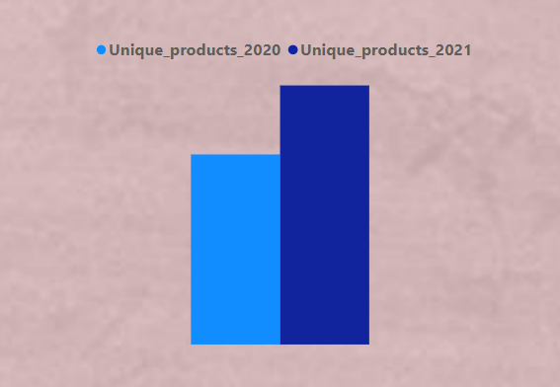
What is the percentage of unique product increase in 2021 vs 2020 ?
2.
36.32 %
INSIGHT : 36.32 % (89 products) of unique producty oncreased in 2021 compare with 2020

Slide 6
Provide a report with all the unique product counts for each segment and
sort them in descending order of product counts.
3.
Segment | Product_count
Notebook | 129
Accessories | 116
Peripherals | 84
Desktop | 32
Storage | 27
Networking | 9
SQL QEURY :
SELECT segment , ( COUNT ( DISTINCT product_code) AS product_count
FROM dim_product
GROUP BY segment
ORDER BY product_count DESC ;

Slide 7
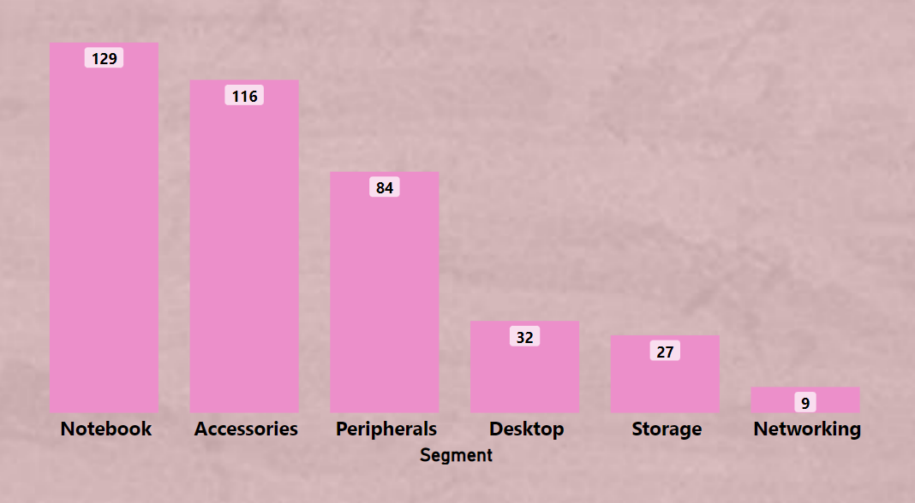
Provide a report with all the unique product counts for each segment and
sort them in descending order of product counts.
3.

Slide 8
Follow-up: Which segment had the most increase in unique products in
2021 vs 2020?
4.
SQL QEURY :
Segment | product_count_2020 | product_count_2021 | Difference
Accessories | 69 | 103 | 34
Desktop | 7 | 22 | 15
Networking | 6 | 9 | 3
Notebook | 92 | 108 | 16
Peripherals | 59 | 75 | 16
Storage | 12 | 17 | 5
WITH pr_count_2021 AS ( SELECT segment ,
COUNT ( distinct p.product_code ) AS product_count_2021
FROM dim_product p
JOIN fact_sales_monthly s ON p.product_code = s.product_code
WHERE fiscal_year = 2021
GROUP BY segment ),
pr_count_2020 as(
SELECT segment , count( distinct p.product_code ) as product_count_2020
FROM dim_product p
LEFT JOIN fact_sales_monthly s ON p.product_code = s.product_code
WHERE fiscal_year = 2020
GROUP BY segment )
SELECT pr_count_2020.segment ,product_count_2020 ,product_count_2021 ,
( pr_count_2021.product_count_2021 - pr_count_2020.product_count_2020 )as difference
FROM pr_count_2021 CROSS JOIN pr_count_2020
ON pr_count_2020.segment = pr_count_2021. segment ;

Slide 9
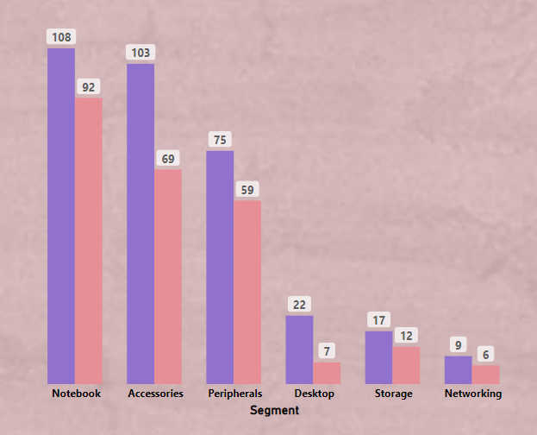
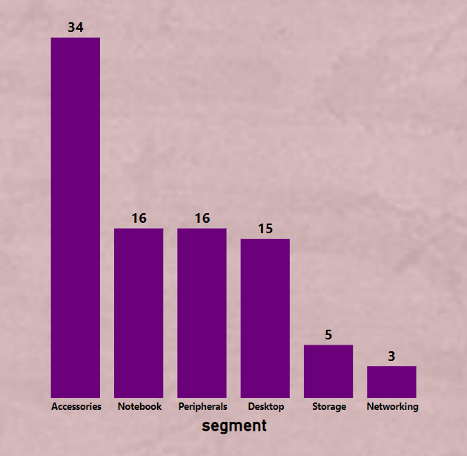
Follow-up: Which segment had the most increase in unique products in
2021 vs 2020?
4.
INSIGHT : IN Accessories segment 34 new product increased in 2021
in notebook , peripherals and desktop are almost equal amount of products increased

Slide 10
Get the products that have the highest and lowest manufacturing costs.
5.
SQL QEURY :
SELECT m.product_code , product , manufacturing_cost
FROM dim_product p JOIN fact_manufacturing_cost m
ON m.product_code = p.product_code
WHERE manufacturing_cost = (SELECT MAX ( manufacturing_cost )
FROM fact_manufacturing_cost )
UNION
SELECT m.product_code , product , manufacturing_cost
FROM dim_product p JOIN fact_manufacturing_cost m
ON p.product_code = m.product_code
WHER manufacturing_cost = ( SELECT MIN ( manufacturing_cost )
FROM fact_manufacturing_cost ) ;
product_code | product | manufacturing_cost
A6120110206 | AQ HOME Allin1 Gen 2 | 240.5364
A2118150101 | AQ Master wired x1 Ms | 0.892

Slide 11
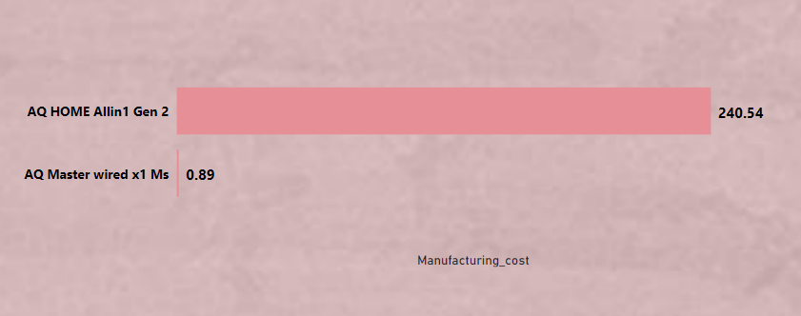
Get the products that have the highest and lowest manufacturing costs.
5.

Slide 12
Generate a report which contains the top 5 customers who received an average high pre_invoice_discount_pct for the fiscal year 2021 and in the Indian market.
6.
SQL QEURY :
Customer_code | Customer | pre_invoice_discount_pct
90002009 | Flipkart | 0.3083
90002006 | Viveks | 0.3038
90002003 | Ezone | 0.3028
90002002 | Croma | 0.3025
90002016 | Amazon | 0.2933
SELECT c.customer_code , customer , pre_invoice_discount_pct
FROM fact_pre_invoice_deductions I JOIN dim_customer c
ON I.customer_code = c.customer_code
WHERE fiscal_year = 2021 AND market = 'India' AND
pre_invoice_discount_pct > ( SEELCT AVG ( pre_invoice_discount_pct )
FROM fact_pre_invoice_deductions )
ORDER BY pre_invoice_discount_pct
DESC LIMIT 5 ;

Slide 13
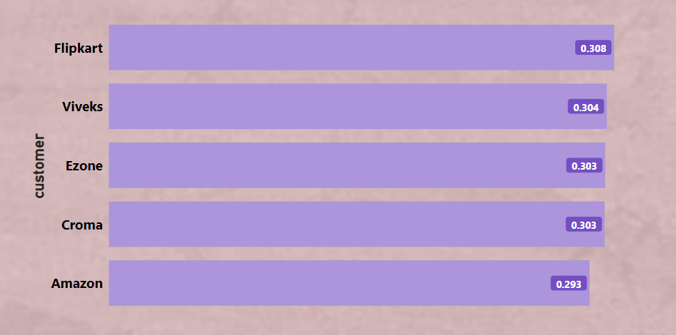
Generate a report which contains the top 5 customers who received an average high pre_invoice_discount_pct for the fiscal year 2021 and in the Indian market.
6.

Slide 14
Get the complete report of the Gross sales amount for the customer “Atliq Exclusive” for each month.
7.
Month | Year | Gross sales Amount
9 | 2019 | 9092670.339
10 | 2019 | 10378637.6
11 | 2019 | 15231894.97
12 | 2019 | 9755795.058
1 | 2020 | 9584951.939
2 | 2020 | 8083995.548
3 | 2020 | 766976.4531
4 | 2020 | 800071.9543
5 | 2020 | 1586964.477
6 | 2020 | 3429736.571
7 | 2020 | 5151815.402
8 | 2020 | 5638281.829
9 | 2020 | 19530271.3
10 | 2020 | 21016218.21
11 | 2020 | 32247289.79
12 | 2020 | 20409063.18
1 | 2021 | 19570701.71
2 | 2021 | 15986603.89
3 | 2021 | 19149624.92
4 | 2021 | 11483530.3
5 | 2021 | 19204309.41
6 | 2021 | 15457579.66
7 | 2021 | 19044968.82
8 | 2021 | 11324548.34
SQL QEURY :
SELECT
MONTH ( date ) AS month , YEAR ( date ) AS year ,
SUM ( gross_price * sold_quantity ) AS Gross_sales_amount
FROM fact_gross_price g
JOIN fact_sales_monthly s ON g. product_code = s.product_code
JOIN dim_customer c ON c. customer_code = s.customer_code
WHERE customer = 'Atliq Exclusive'
GROUP BY MONTH ( date ) , YEAR ( date )
ORDER BY YEAR ( date ) ;

Slide 15
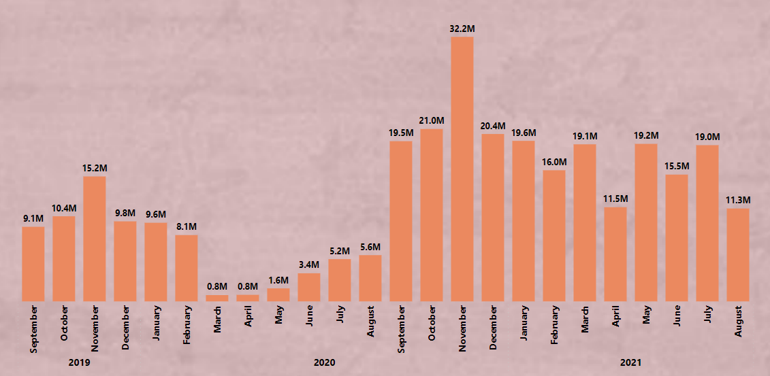
Get the complete report of the Gross sales amount for the customer “Atliq Exclusive” for each month.
7.
INSIGHT :
In the month november 2020 had the highest sales for “Atliq Exclusive” with 32.2M and march 2019 had the lowest sales with 0.8M
March 2019 to june 2020 records the less sale on other hand september 2020 to july 2021 records the more sales except april

Slide 16
In which quarter of 2020, got the maximum total_sold_quantity?
8.
SQL QEURY :
Quarter | total_sold_quantity
1 | 7005619
2 | 6649642
4 | 5042541
3 | 2075087
SELECT
CASE
WHEN date BETWEEN ' 2019-09-01 ' AND ' 2019-11-01 ' then 1
WHEN date BETWEEN ' 2019-12-01 ' AND ' 2020-02-01 ' then 2
WHEN date BETWEEN ' 2020-03-01 ' AND ' 2020-05-01 ' then 3
WHEN date BETWEEN ' 2020-06-01 ' AND ' 2020-08-01 ' then 4
END AS Quarter ,
SUM ( sold_quantity ) AS total_sold_quantity
FROM fact_sales_monthly
WHERE fiscal_year = 2020
GROUP BY Quarter
ORDER BY total_sold_quantity DESC ;

Slide 17
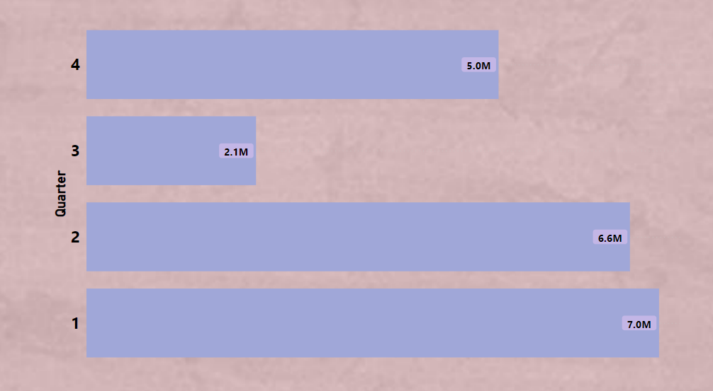
In which quarter of 2020, got the maximum total_sold_quantity?
8.
INSIGHT : Quarter no 1 gots the
maximum sold quantity with '7005619' sold quantity

Slide 18
Which channel helped to bring more gross sales in the fiscal year 2021
and the percentage of contribution?
9.
SQL QEURY :
WITH
CHANNEL AS (
SELECT CHANNEL ,
SUM ( round ( ( sold_quantity * gross_price ) / 1000 , 2 ) ) AS gross_sales_mln
FROM dim_customer C
INNER JOIN fact_sales_monthly S ON C.customer_code = S.customer_code
INNER JOIN fact_gross_price G ON S.product_code = G.product_code
WHERE S.fiscal_year = 2021
GROUP BY CHANNEL )
SELECT CHANNEL , gross_sales_mln ,
ROUND ( ( S. gross_sales_mln / TOTAL_SALES.TOTAL ) * 100 , 2 ) AS Percentage
FROM CHANNEL AS S CROSS JOIN
( SELECT SUM ( gross_sales_mln ) AS TOTAL FROM CHANNEL ) TOTAL_SALES
ORDER BY gross_sales_mln DESC ;
CHANNEL | gross_sales_mln | Percentage
Retailer | 1924188.24 | 73.22
Direct | 406689.34 | 15.47
Distributor | 297176.64 | 11.31

Slide 19
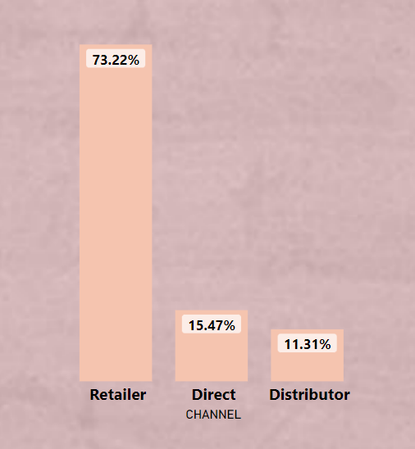
Which channel helped to bring more gross sales in the fiscal year 2021
and the percentage of contribution?
9.
INSIGHT : Retailer channel brings more sales with 73.22 % in the fiscal year 2021 .

Slide 20
Get the Top 3 products in each division that have a high
total_sold_quantity in the fiscal_year 2021?
10.
division | product_code | product | total_sold_quantity | Rank
N & S | A6720160103 | AQ Pen Drive 2 IN 1 | 701373 | 1
N & S | A6818160202 | AQ Pen Drive DRC | 688003 | 2
N & S | A6819160203 | AQ Pen Drive DRC | 676245 | 3
P & A | A2319150302 | AQ Gamers Ms | 428498 | 1
P & A | A2520150501 | AQ Maxima Ms | 419865 | 2
P & A | A2520150504 | AQ Maxima Ms | 419471 | 3
PC | A4218110202 | AQ Digit | 17434 | 1
PC | A4319110306 | AQ Velocity | 17280 | 2
PC | A4218110208 | AQ Digit | 17275 | 3
SQL QEURY :
WITH SALES AS ( SELECT division , M.product_code , product ,
SUM ( sold_quantity ) AS total_sold_quantity
FROM fact_sales_monthly AS M
LEFT JOIN dim_product AS P ON M.product_code = P.product_code
WHERE fiscal_year = 2021
GROUP BY M.product_code , division,product ) ,
RANK AS ( SELECT product_code , total_sold_quantity ,
DENSE_RANK () OVER ( PARTITION BY division
ORDER BY total_sold_quantity desc ) AS Rank_order
FROM sales AS S )
SELECT division , S.product_code , product , S.total_sold_quantity , Rank_order
FROM sales AS S INNER JOIN rankk AS R ON R.product_code = S.product_code
WHERE Rank_order BETWEEN 1 AND 3;

Slide 21

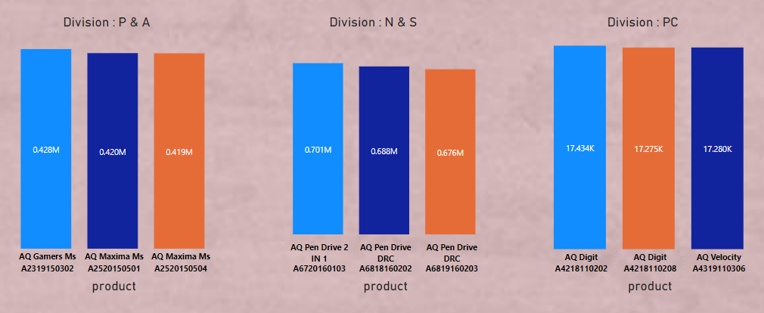
Get the Top 3 products in each division that have a high
total_sold_quantity in the fiscal_year 2021?
10.
INSIGHT : 26.3 % ( 3385444 Sold Quantity) contribution of these 9 parts in P & A , N & S , PC division
division P & A having the most product sale with 76 %

